Slide 1
Module 1: Introduction to 8086 Microprocessor

Slide 2
Introduction to 8086

Slide 3
What is a microprocessor?
Micro – very small
Processor – device that processes numbers, especially binary numbers
In 1960’s processors were built using different elements that were too large and slow.
In 1970’s, microchips were invented where all components were mounted on a silicon chip.
The size came down 1000 times and the speed of the processors improved immensely.
Thus, microprocessors were born.

Slide 4
How does Microprocessor differs from microcontroller?
Microprocessor – Multipurpose programmable device, gets digital input, processes it according to the instructions that are stored in memory, and provides the output.
Microcontroller – A small computer on a single IC, has processor core, memory, and input-output peripherals.

Slide 5
History of microprocessors
1971 – 4004 – 4 bits - 740kHz
1976 – 8085 – 8 bits – 3MHz
1978 – 8086 – 16 bits – 5, 8 or 11 MHz
1986 – 80386 – 32 bits – 16 to 33 MHz
1993 – Pentium – 32 bits - 66MHz
2000 – Pentium IV – 32 bits – 1.3 to 3.8 GHz
2006 – Dual Core – 32 bits – 1.2 to 3 GHz
2006 – Core 2 Duo – 64 bits – 1.2 to 3 GHz
2010 – i3, i5, i7- 64 bits – 2.4 GHz to 3.6 GHz

Slide 6
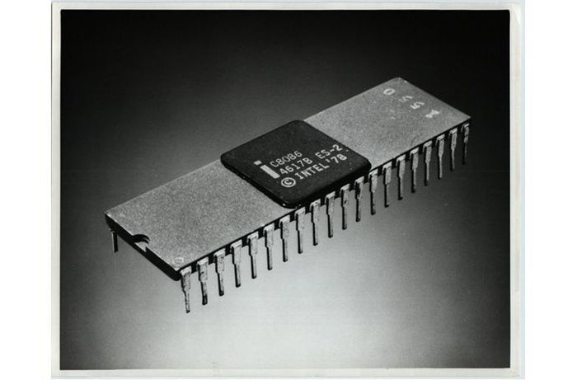
8086 microprocessor
Source:
https://www.pcworld.com/article/146957/article.html as on 14 July 2020

Slide 7
Features of 8086 microprocessor
16 bit microprocessor
16 bit data bus, hence read/write operation – 16 bits at a time
20 bit address bus – 2²⁰ address locations (1MB)
Supports up to 64KHz I/O ports
14, 16 bit registers
Multiplexed address and data buses
Fetches up to 6 instructions from memory and queues them to speed up processing
Supports minimum and maximum mode of operations

Slide 8
Weblinks
https://www.pcworld.com/article/146957/article.html
https://www.tutorialspoint.com/microprocessor/microprocessor_8086_overview.htm

